Slide 1


Agenda
Selenium Automation
Selenium Framework
Selenium Automation
Selenium Execution
Selenium Reporting
Katalon Automation
Katalon Framework
Katalon Test Design and Object Page Model
Katalon Execution
Katalon Reporting
JMeter Performance Testing
JMeter Performance Plan Framework
JMeter Design of Automation Web & API
JMeter Execution & Monitoring
JMeter Reporting

Slide 2
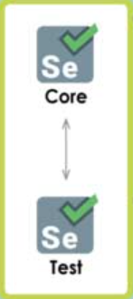
Automation Framework Overview
Configuration
Classes
Step Logs
Test Summary Results
Screen Shots
HMTL Customized Results
Driver Manager
Maven Pom.XML
Web Scenarios
Web Element Wrapper
TestNG
Page Object model
Business Logic
Assertions &Screen Shots
Test Results
Test Result Config
Browser Setting
Extent Reports
Data Driven

Slide 3

Performance Testing Overview
Requirements
Logs
Test Summary Results
System Monitoring
HMTL Customized Results
Performance Plan
Test Design
Apache JMeter
Execution
Analysis & Monitoring
Test Results
Reports

Slide 4

Thank You

